Slide 1
Outline
Maxwell Equations
Constitutive Relations
Lossy Medium
Metamaterials
Boundary Conditions
Wave Equations
Wave Propagation
Polarization
Plane Wave Reflection and Refraction
Poynting Vector

Slide 2
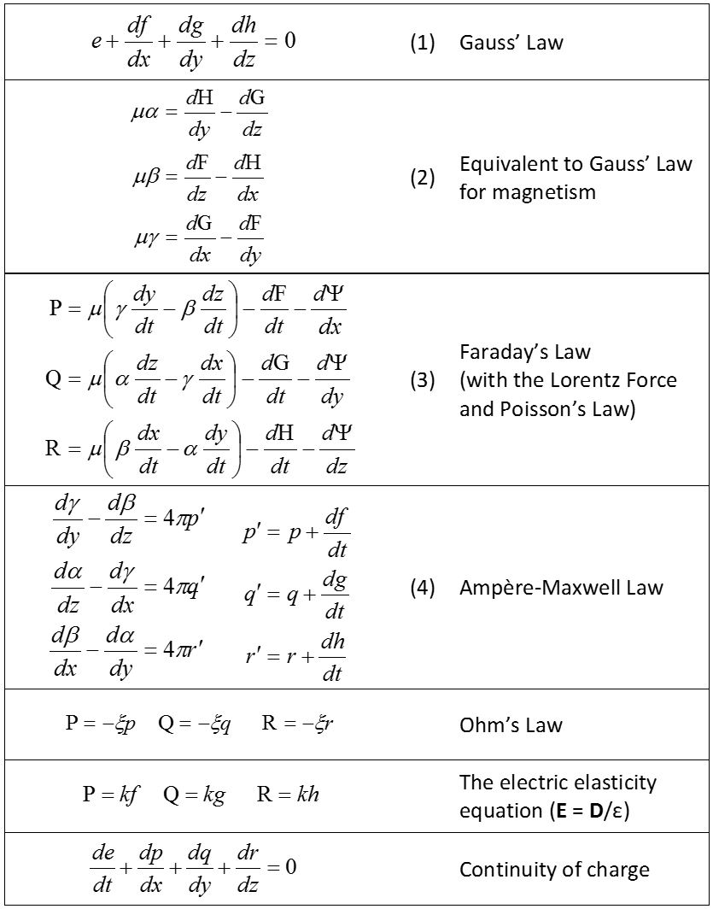
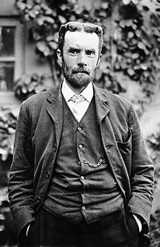
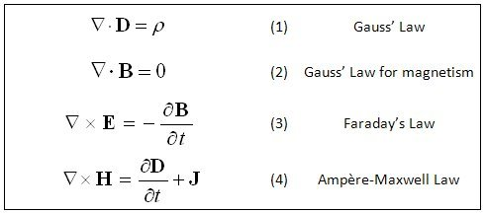
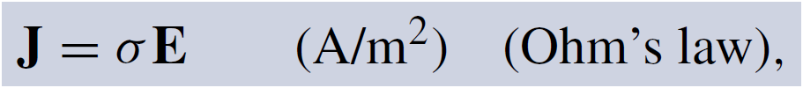
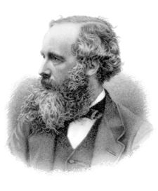
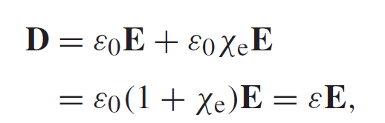
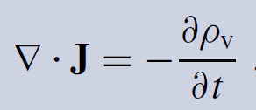
Maxwell Equations
Oliver Heaviside
Modern Form in 1884
Original Form in 1865

Slide 3
Maxwell Equations
From Wikipedia
Name | Differential form | Integral form
Gauss's law
Gauss's law for magnetism
Maxwell–Faraday equation (Faraday's law of induction)
Ampère's circuital law (with Maxwell's correction)
The asymmetry in Maxwell Equations is due to the absence of the magnetic monopole!

Slide 4
Definitions and Units
From Wikipedia
Symbol | Meaning (first term is the most common) | SI Unit of Measure
 | electric field also called the electric field intensity | V/m
 | magnetic field also called the magnetic induction also called the magnetic field density also called the magnetic flux density | T Wb/m²
 | electric displacement field also called the electric induction also called the electric flux density | C/m²
 | magnetizing field also called auxiliary magnetic field also called magnetic field intensity also called magnetic field | A/m
 | permittivity of free space, also called the electric constant, a universal constant | F/m
 | permeability of free space, also called the magnetic constant, a universal constant | H/m
 | total charge density (including both free and bound charge) | C/m³
 | total current density (including both free and bound current) | A/m²
 | net electric charge within the three-dimensional volume V (including both free and bound charge) | C

Slide 5
Constitutive Relations
Uniform and Isotropic Materials
ε_{r} relative dielectric constant
ε₀ dielectric constant in free space (8.854×10⁻¹²)
µ_{r} relative permeability
µ₀ permeability in free space (4π×10⁻⁷)

Slide 6
Lossy Medium
Complex Permittivity
For materials with conductivity:
Loss tangent

Slide 7
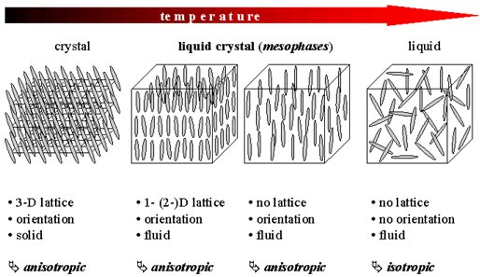
Anisotropic Medium
Tensor

Slide 8
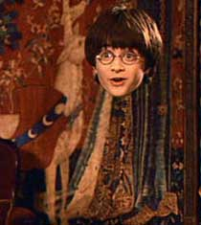
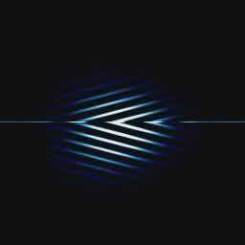
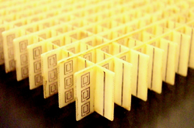
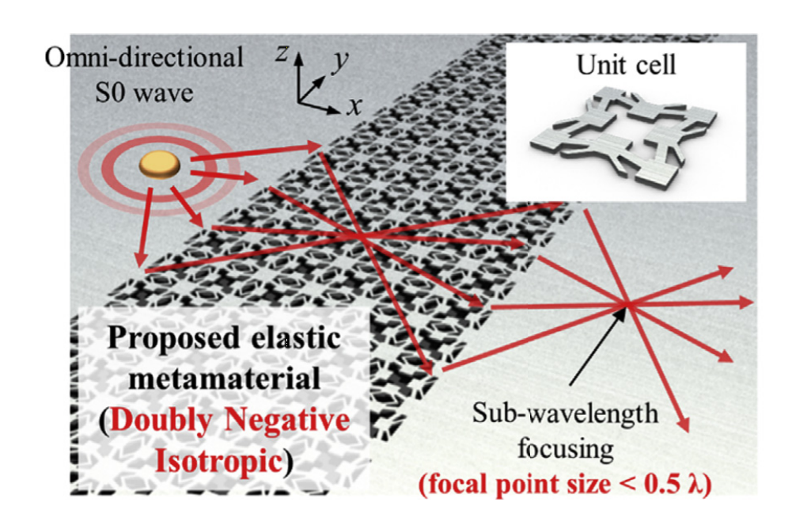
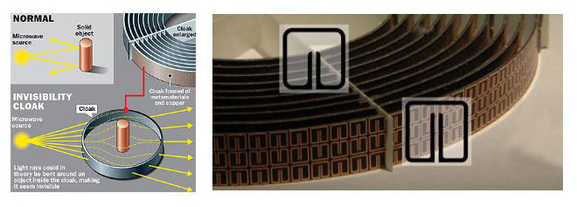
Left-Handed Metamaterials
What if ε and µ are negative?
Negative Refraction at Microwave Frequencies – D. R. Smith (UCSD)
On my Wish List
Negative Refraction
Cloaking - J. B. Pendry (ICL)
Sub-Wavelength Focusing (Korea)

Slide 9
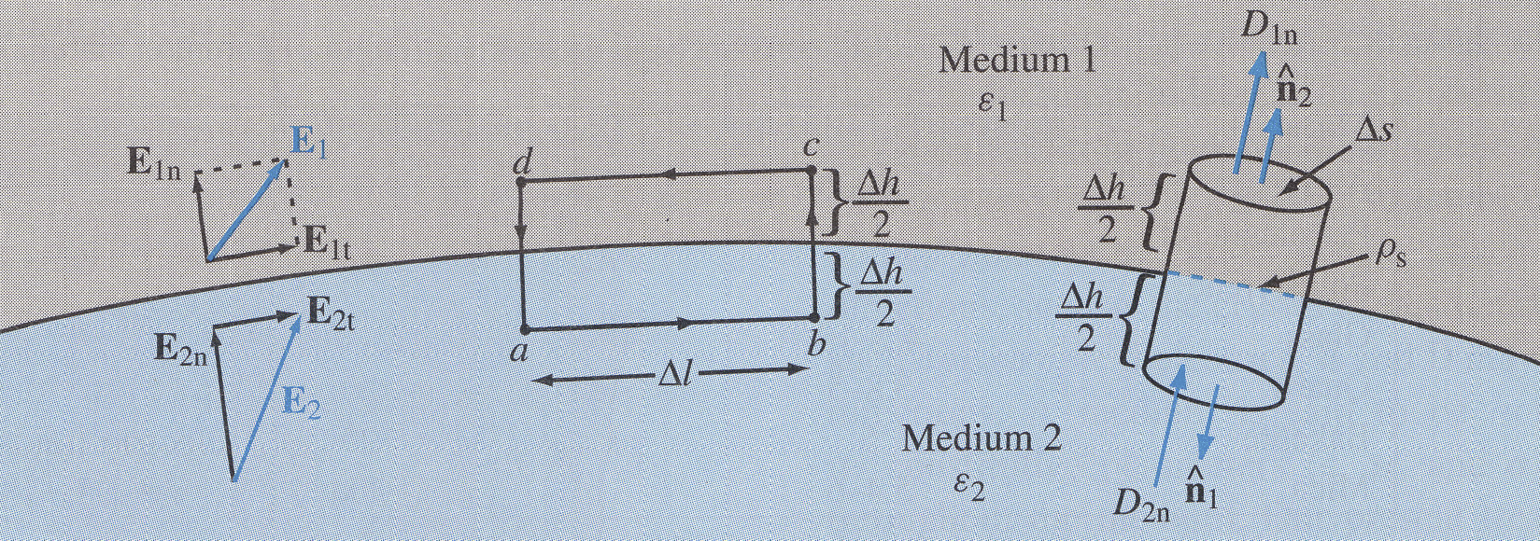
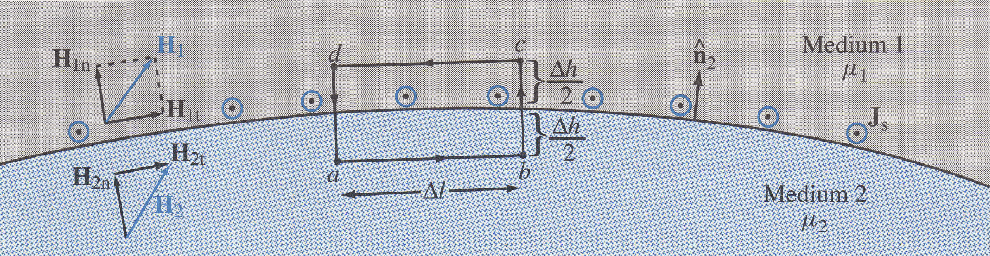
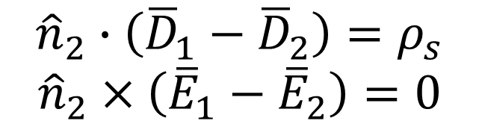
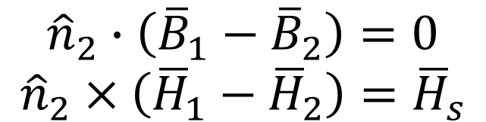
Boundary Conditions
$${\hat{n}}_{2}∙\left({\overline{D}}_{1}−{\overline{D}}_{2}\right)=ρ_{s}$$
$${\hat{n}}_{2}×\left({\overline{E}}_{1}−{\overline{E}}_{2}\right)=0$$
$${\hat{n}}_{2}∙\left({\overline{B}}_{1}−{\overline{B}}_{2}\right)=0$$
$${\hat{n}}_{2}×\left({\overline{H}}_{1}−{\overline{H}}_{2}\right)={\overline{H}}_{s}$$

Slide 10
Wave Equations
In vacuum and charge free space:
Identity:
Helmholtz equation

Slide 11
Solve Helmholtz Equations
The general solution to the electromagnetic wave equation is a linear superposition of waves of the form:
Forward Wave
Backward Wave
Angular frequency (rad/s)
Wave number

Slide 12
Wave Propagation in Lossless Medium
Assume a uniform (no variations in x and y directions) plane wave travelling in +z direction. In addition, we assume the E field exhibits x component only.
Practice by yourself

Slide 13
Wave Propagation in Lossless Medium
For time harmonic cases
Helmholtz equation

Slide 14
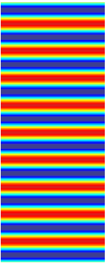
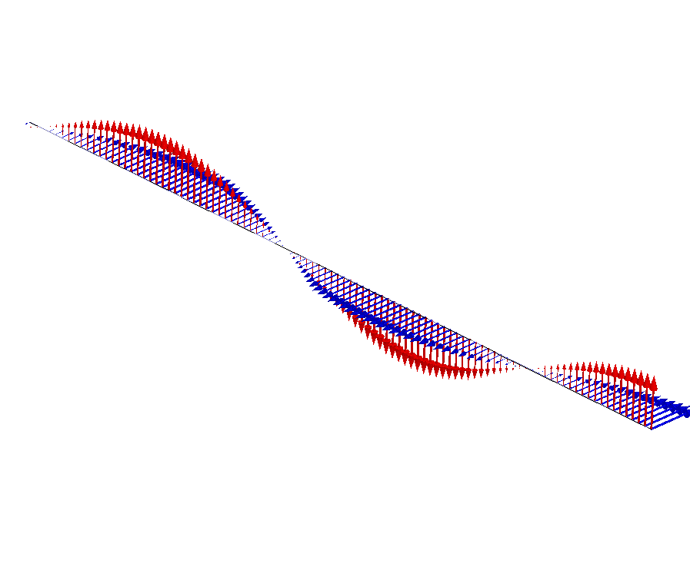
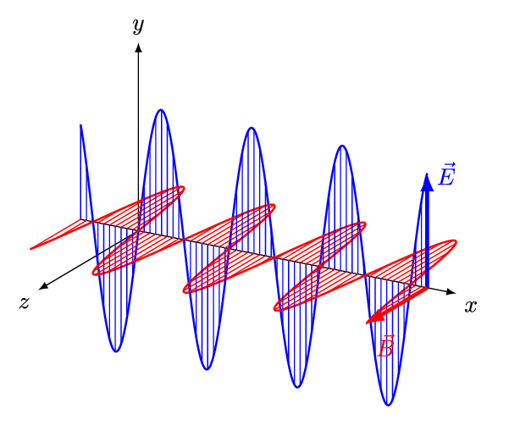
Wave Propagation in Lossless Medium
The E and H field expressions for a plane wave:
Propagation constant (rad/m)
Wavelength (m)
z
Wave Impedance or Intrinsic impedance (ohm)
z

Slide 15
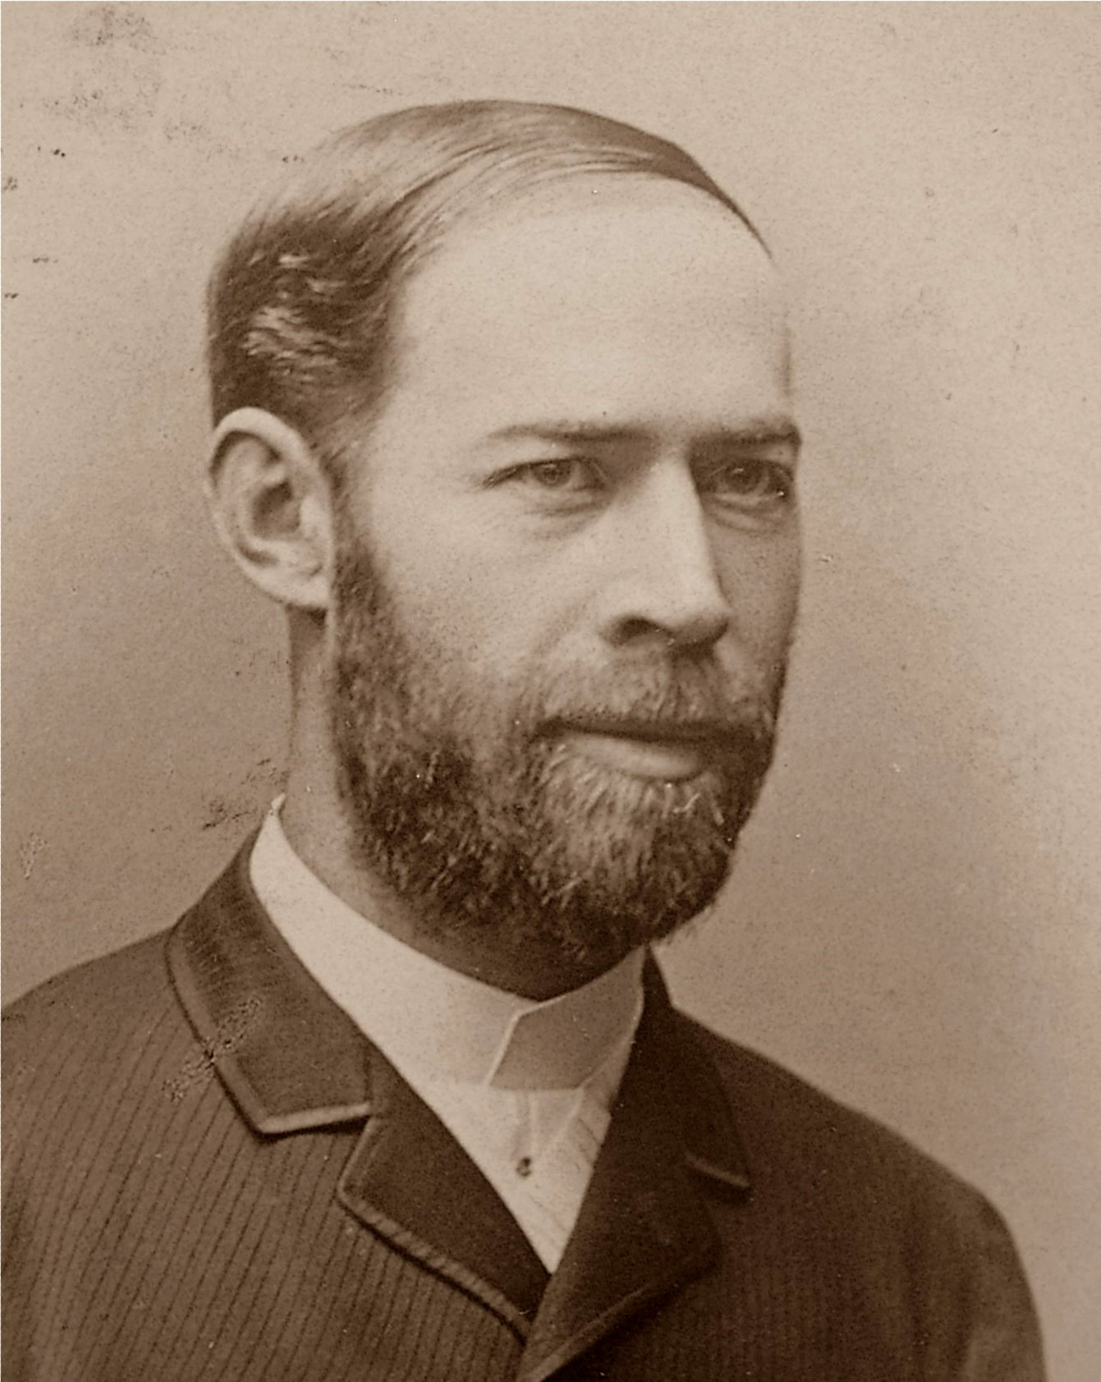
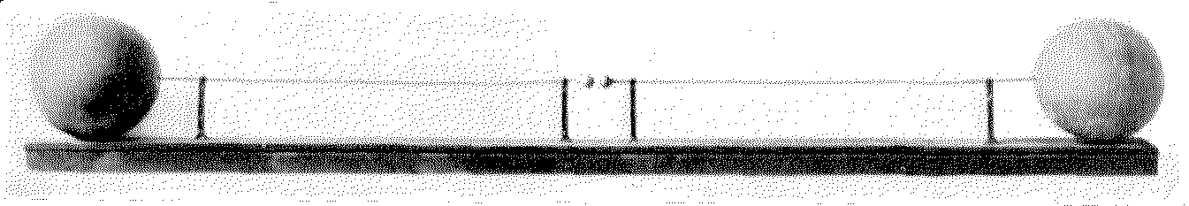
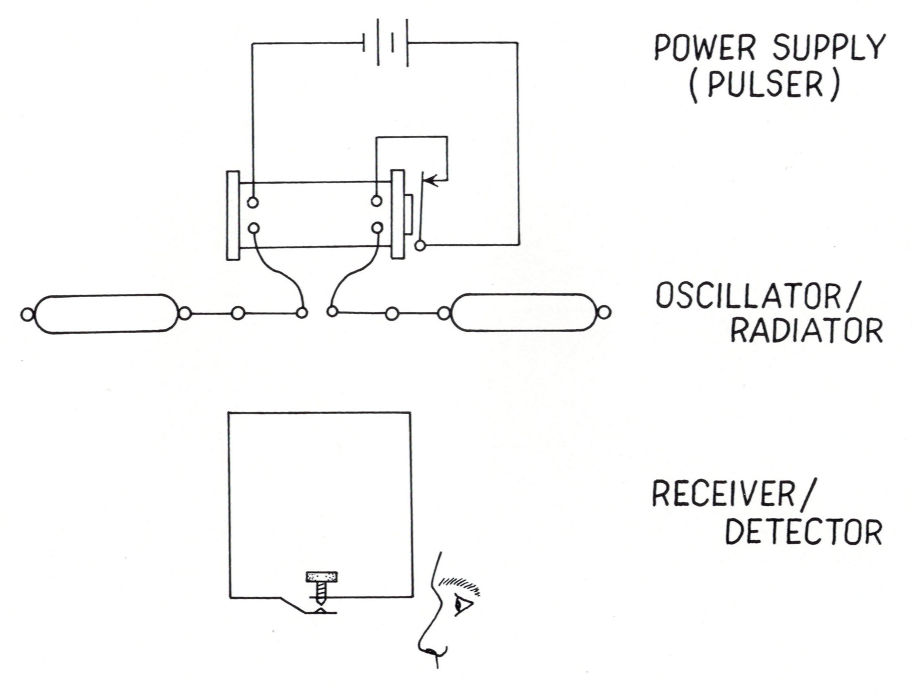
First Demo of Wave Propagation By Hertz
Heinrich Rudolf Hertz
Hertz did not realize the practical importance of his radio wave experiments. He stated that,^{[17][18][19]}
"It's of no use whatsoever[...] this is just an experiment that proves Maestro Maxwell was right—we just have these mysterious electromagnetic waves that we cannot see with the naked eye. But they are there."
Asked about the applications of his discoveries, Hertz replied,^{[17][20]}
"Nothing, I guess."
50 MHz
Experiment in 1884

Slide 16
Wave Propagation in Lossy Medium

Slide 17
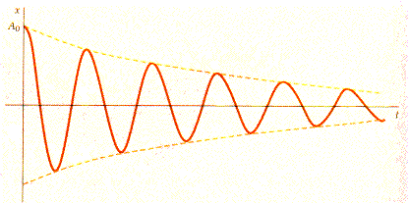
Wave Propagation in Lossy Medium
Complex propagation constant
Attenuation constant
Propagation constant
For low-loss materials
z

Slide 18
Wave Propagation in Conductors

Slide 19
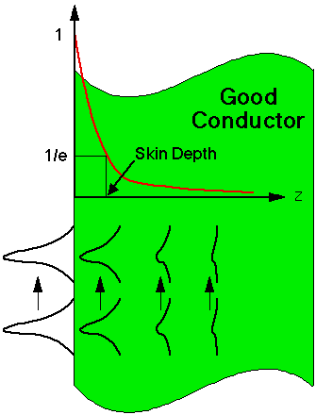
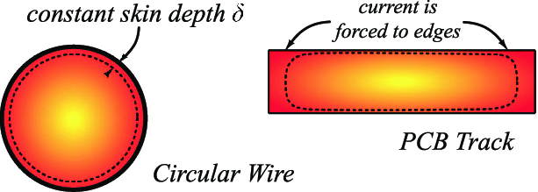
Wave Propagation in Conductors
Skin depth
The field intensity is reduced to 1/e of the incident fiend when the field travels one skin depth
Complex wave impedance
The E field phase is 45 degree ahead of the H field phase

Slide 20
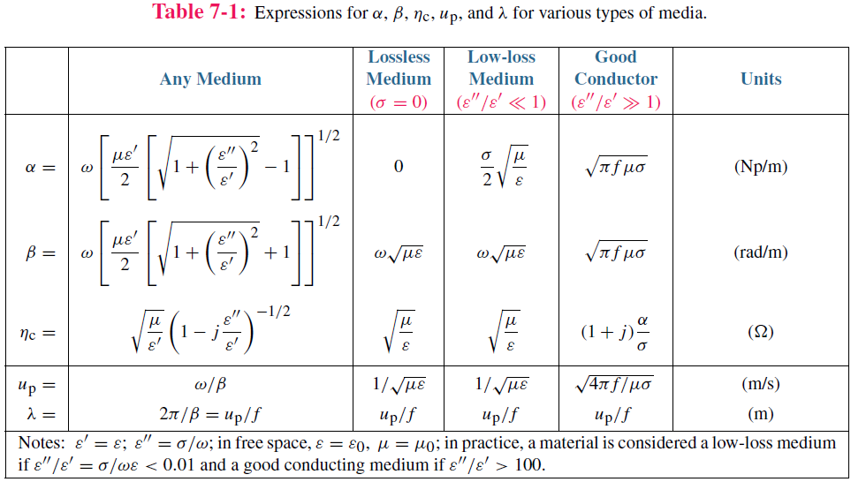

Slide 21
Polarization
A Plane Wave Travelling in +z direction:

Slide 22
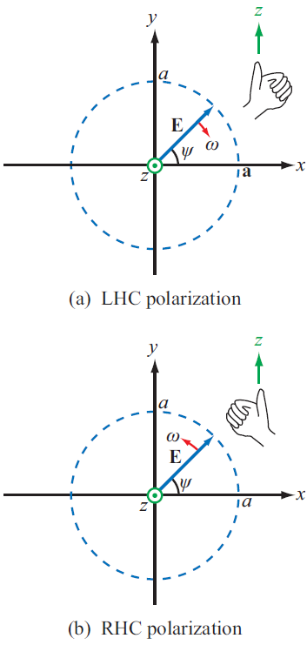
Polarization
Let

Slide 23
Polarization
Let’s see how α changes with time

Slide 24
Polarization
y
1. If δ=0 or pi, dα/dt=0, α is constant
α
x
Linear Polarization
z
2. If 0<δ<pi, dα/dt<0,
Left Handed Polarization
3. If -pi<δ<0, dα/dt>0,
Right Handed Polarization

Slide 25
Polarization

Slide 26
Polarization

Slide 27
Polarization
An ellipse can be represented by 4 quantities:
size of minor axis
size of major axis
orientation (angle)
sense (CW, CCW)

Slide 28
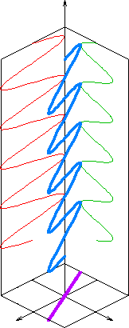
Linear Polarization
When δ = 0 or pi

Slide 29
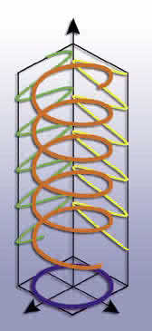
Circular Polarization
When δ = 90º or -90º and |E_{x0}|= |E_{y0}|

Slide 30
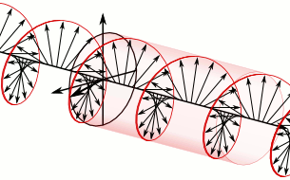
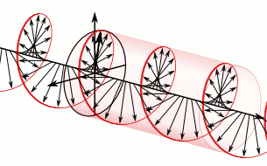
LHCP or RHCP
When δ = -90º and |E_{x0}|= |E_{y0}|
When δ = 90º and |E_{x0}|= |E_{y0}|
RHCP
LHCP

Slide 31
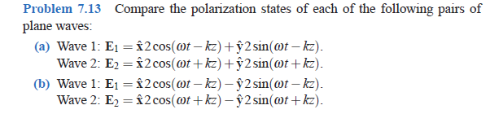
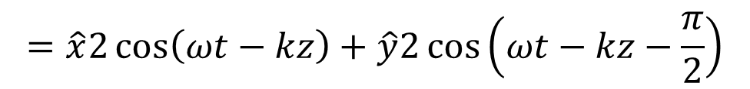
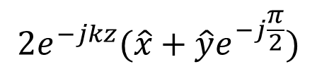
Example: How to Judge RHCP or LHCP
$$=\hat{x}2\cos\left(ωt−kz\right)+\hat{y}2\cos\left(ωt−kz−\frac{π}{2}\right)$$
Time Domain
$$2e^{−jkz}(\hat{x}+\hat{y}e^{−j\frac{π}{2}})$$
Phasor Domain
z
k
k
-90º
y
0º
RHCP
x

Slide 32
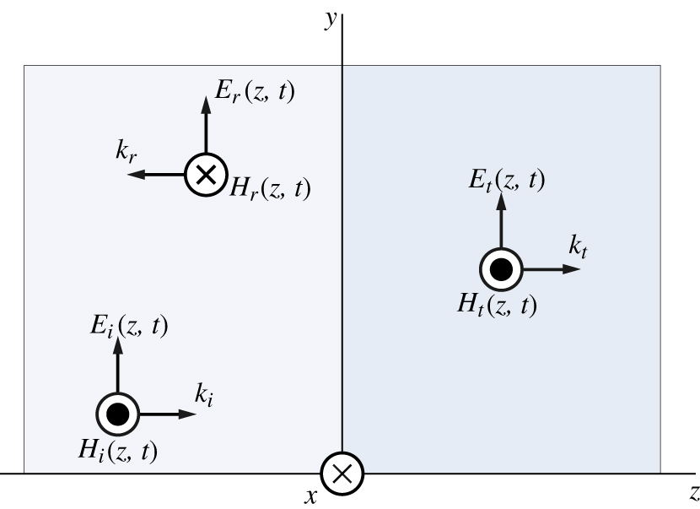
Normal Incidence @ Dielectric Boundary
From Boundary Conditions:
From Wave Impedance:

Slide 33
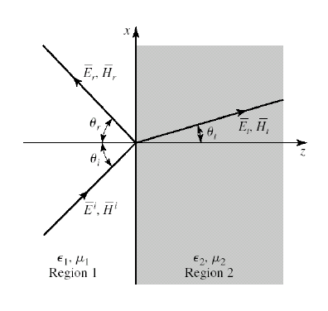
Oblique Incidence @ Dielectric Boundary
Incident Wave:
Reflected Wave:
Transmitted Wave:
At the boundary: for any r when z=0:
All the waves must be in the same plane. From Snell’s Law:

Slide 34
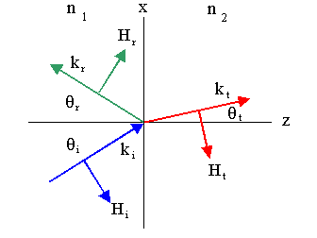
Perpendicular Polarization (TE)
The incident, reflected, and transmitted electric field vectors are perpendicular to the plane of incidence: the x-z plane.

Slide 35

Parallel Polarization (TM)
The incident, reflected, and transmitted electric field vectors are parallel to the plane of incidence: the x-z plane.

Slide 36
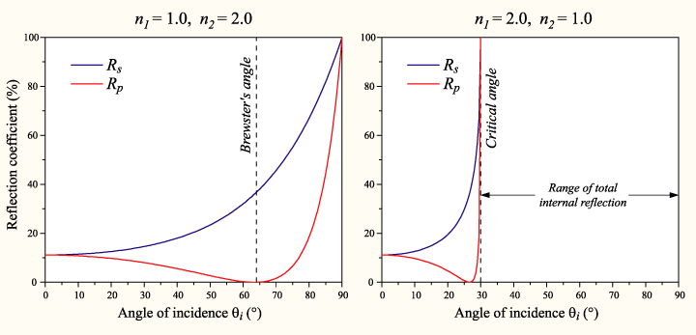
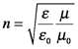
Total Reflection and Brewster Angle

Slide 37
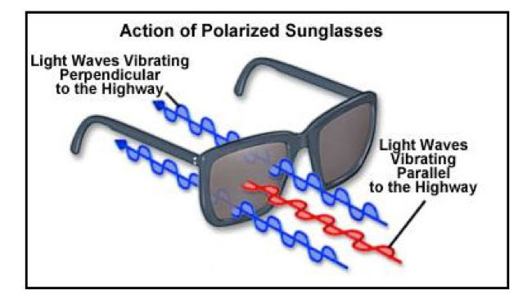

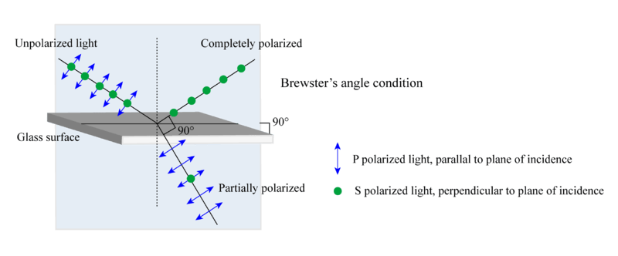
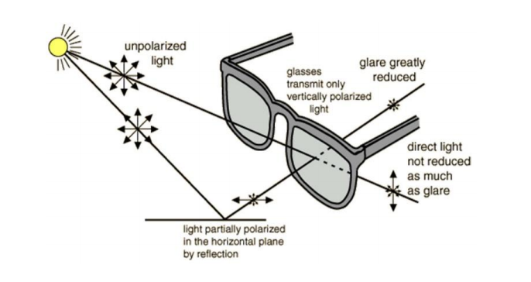
Polarized Sunglasses and Brewster Angle
With Polarizer

Slide 38
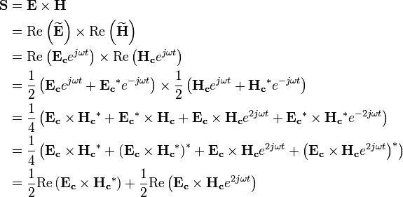
Poynting Vector
From Wikipedia
In physics, the Poynting vector represents the directional energy flux density (the rate of energy transfer per unit area, in Watts per square metre, W·m⁻²) of an electromagnetic field. It is named after its inventor John Henry Poynting. Oliver Heaviside and Nikolay Umov independently co-invented the Poynting vector.
In Poynting's original paper and in many textbooks, it is usually denoted by S or N, and defined as:^{[1][2]}
For time-periodic sinusoidal electromagnetic fields, the average power flow per unit time is often more useful, and can be found by treating the electric and magnetic fields as complex vectors as follows (star * denotes the complex conjugate):

Slide 39
Time-Averaged Poynting Vector
From Wikipedia

Slide 40
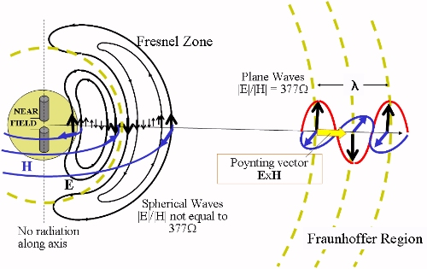
Poynting Vector
From Wikipedia

